Slide 1

Tmall Smartphone sells information analysis
Duo Zhang
Guanqi Guo

Slide 2

Translate
Tian Mao: Tmail, an offical online store of Taobao, like Amazon Prime.
Taobao: The most popular online trading platform in China.
Data: credible

Slide 3
Goals
Find the most related attribute to the price.
Find the relationship between popular value, price, and monthly sale.
If people want to buy a smartphone with some situations, predict how much they will spend or which type of smartphones is the best choice.

Slide 4
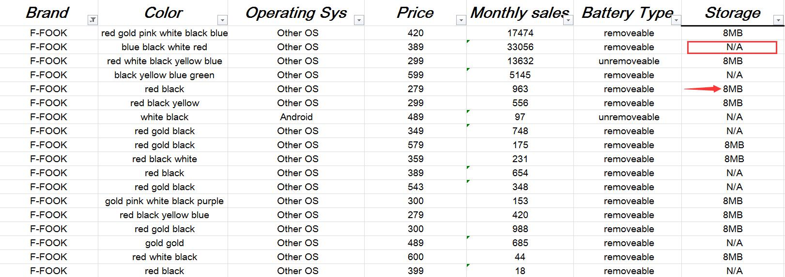
Preprocess
Use the mode of the brand to replace the missing values.

Slide 5
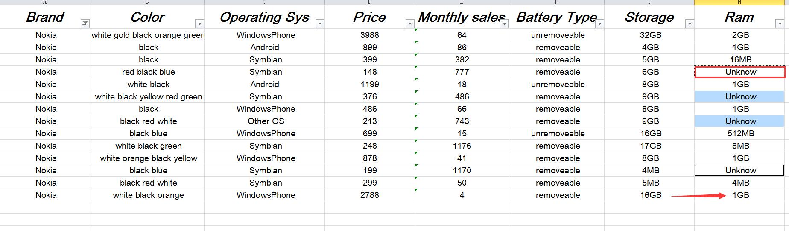
Preprocess
Use the mode of the brand to replace the missing values.

Slide 6
Preprocess
Use the other value of the brand to replace the missing values.

Slide 7
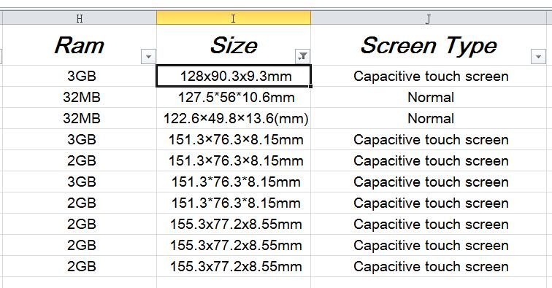
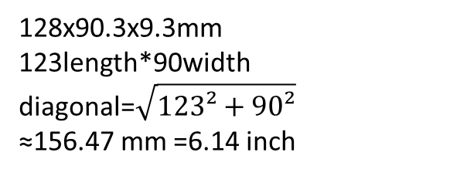
Clean
128x90.3x9.3mm
123length*90width
diagonal=$\sqrt{123²+90²}$
≈156.47 mm =6.14 inch
Change the size from millimeter to inch:

Slide 8
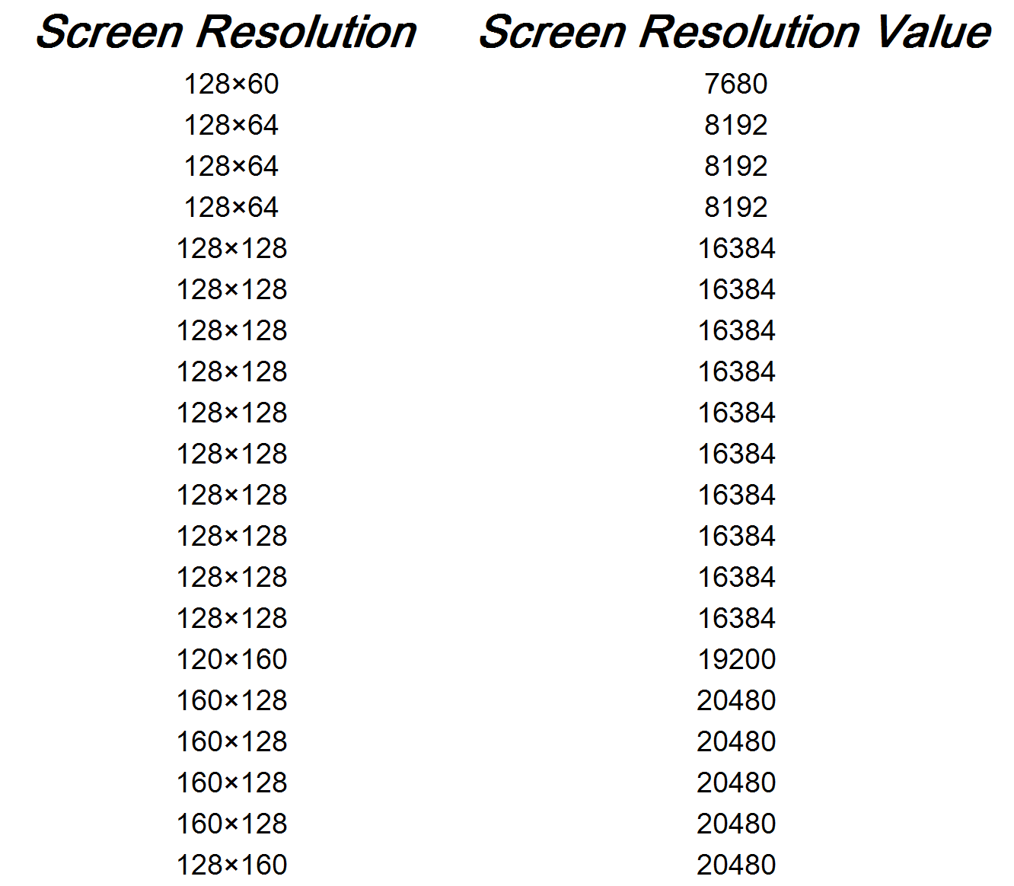
Clean
Change the Screen Resolution from equation to value:
That means there are how many pixels on the unit area.

Slide 9
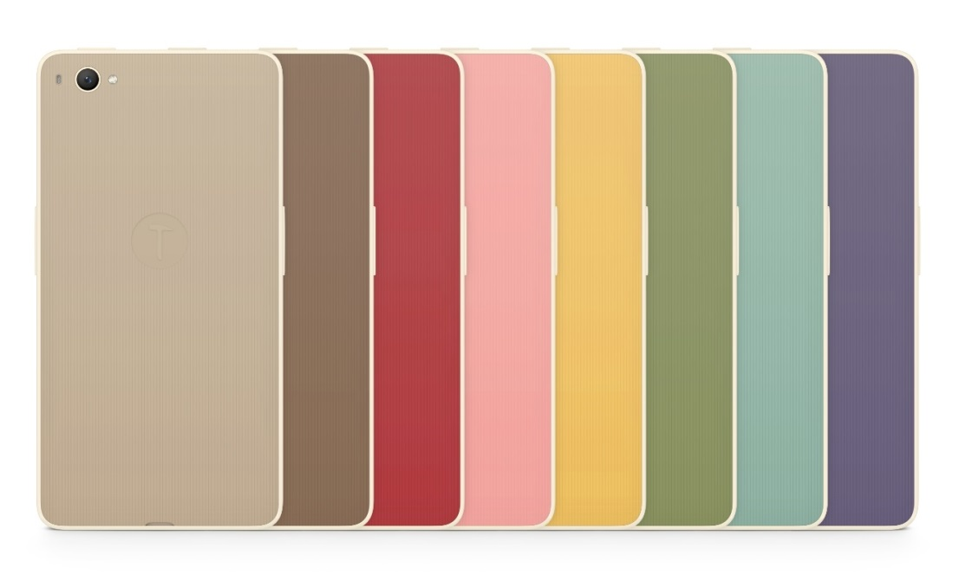
Clean
Color: gold, beach gold, sunset gold, glory gold, earl gold;
all to gold;
SMARTISAN cell phone: Mouse, chestnut, sapanwood, pink (a kind of flower), withered grass, celadon china, bamboo tea, turtledove feather;
gray, red, pink, blue, brown, green, yellow, purple;

Slide 10
Classify and smooth
Price: five groups (Depends on the quantity:
each group has around 200 values)
under 400 yuan (about 50 dollars)----very low
from 400 yuan to 750 yuan (about 100 dollars)----low
from 750 yuan to 1400 yuan (about 200 dollars)----medium
from 1400 yuan to 2400 yuan (about 350 dollars)----high
above 2400 yuan ----very high

Slide 11
Classify and smooth
Size: three groups (Depends on the value of number)
under 4.3 inch----small
from 4.3 inch to 5.0 inch----medium
above 5.0 inch----big
Ram: four groups (Depends on the value of number)
under 1MB----small
from 1MB to 1GB (not include 1GB)---- medium
from 1GB to 3GB (not include 3GB)----large
above 3GB----very large

Slide 12
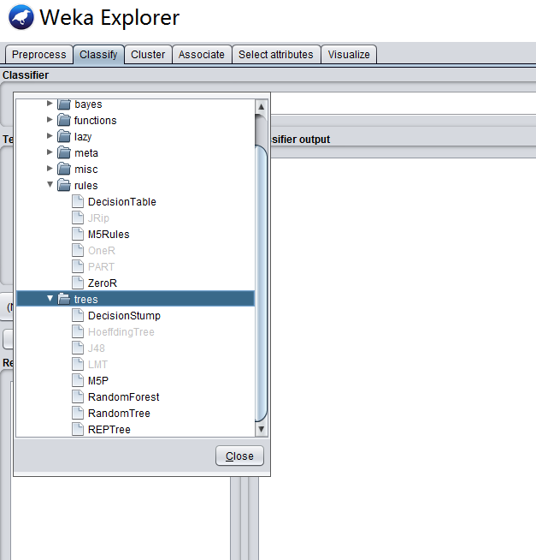
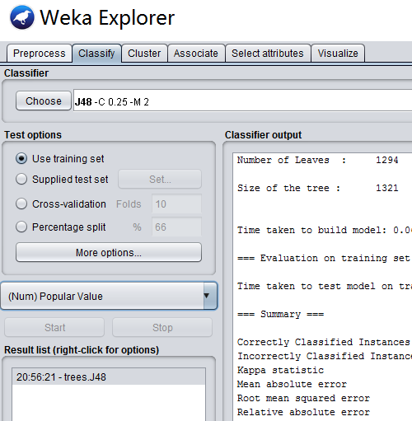
Weka
Before using Weka: change the value type to numeric and norminal.

Slide 13
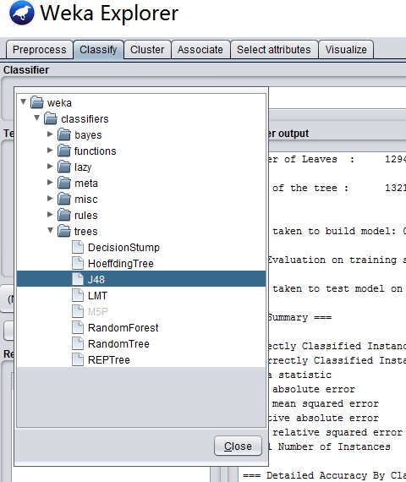
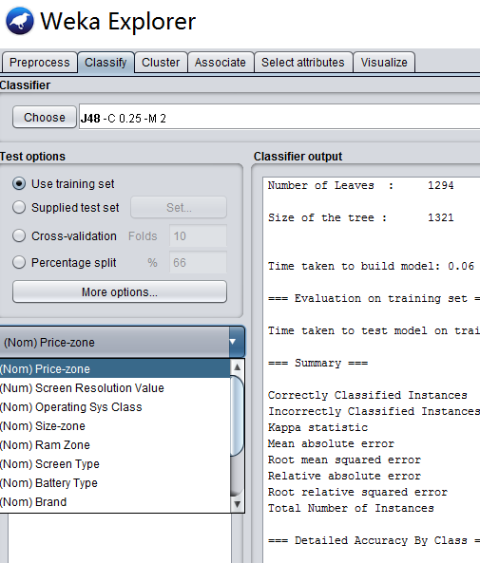
Weka
Use J48 (C4.5) to calculate if the value after smoothed is effective.

Slide 14
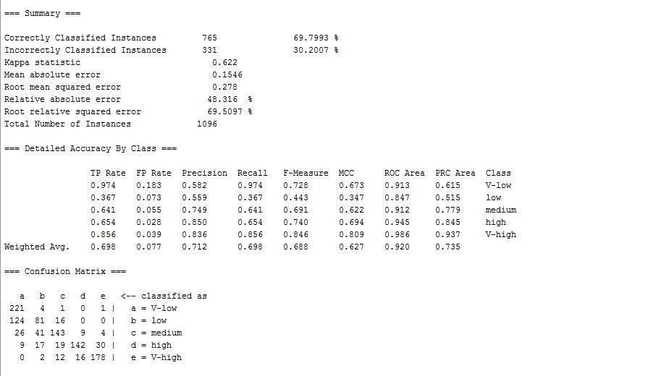
Weka
Use J48 (C4.5) to calculate if the value after smoothed is effective.

Slide 15
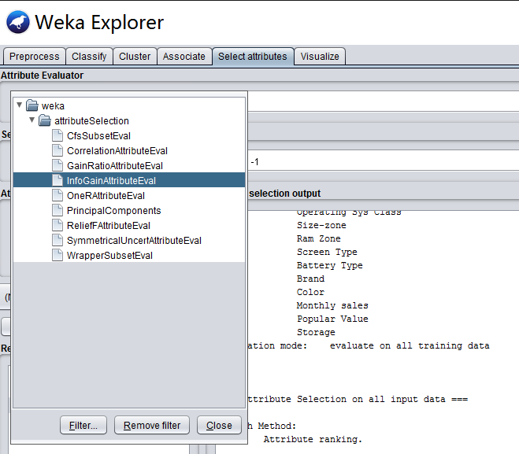
Weka
Use InfoGain method to find the related attributes to the price.

Slide 16
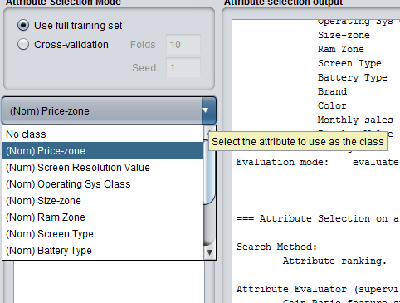
Weka
Use InfoGain method to find the related attributes to the price.

Slide 17
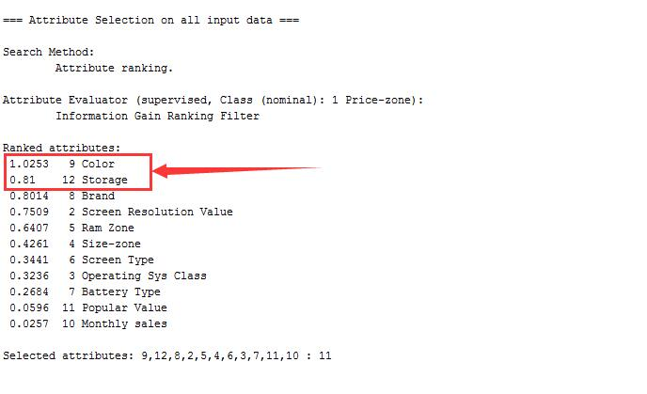
Weka
Use InfoGain method to find the related attributes to the price.
Have more than one value in a cell

Slide 18
Conclusion
After processing the data by using Weka, we find:
The Screen Resolution is most related attribute to the price except the brand.
Price does not have much relationship with popular value and monthly sale.
If some one want to buy a smartphone which has a high cost performance, he should choose brands carefully.

Slide 19
Thank you !

